Slide 1




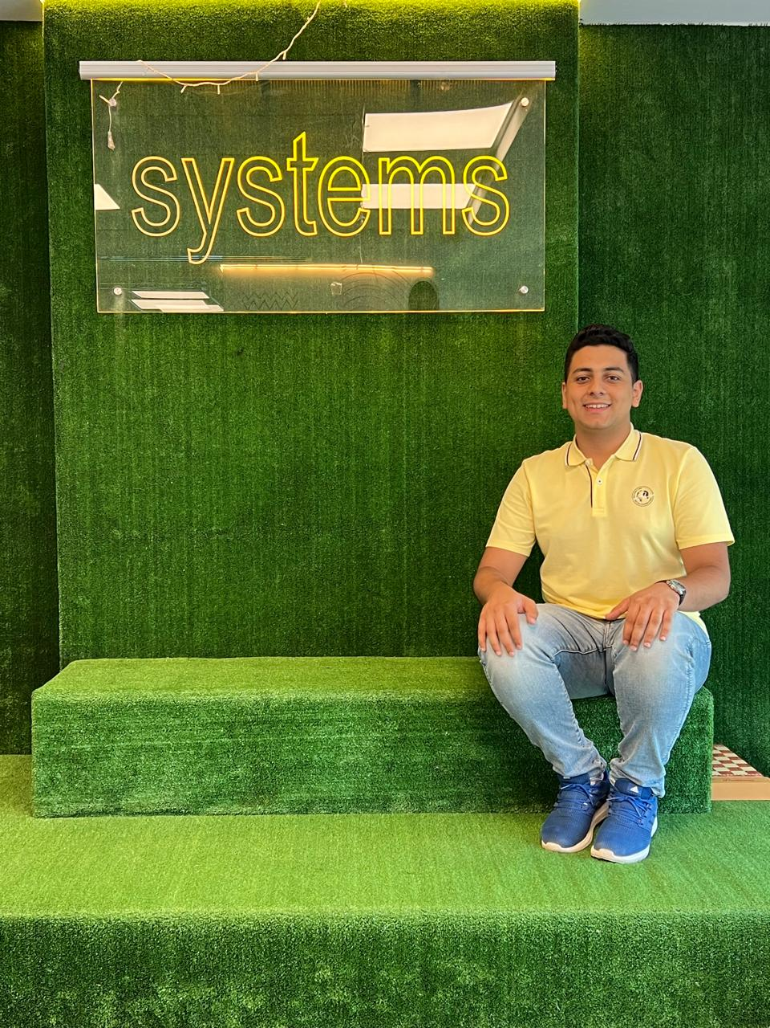








BRAIN TUMOR DETECTION
Created by “Teta Byte Team”

Slide 2
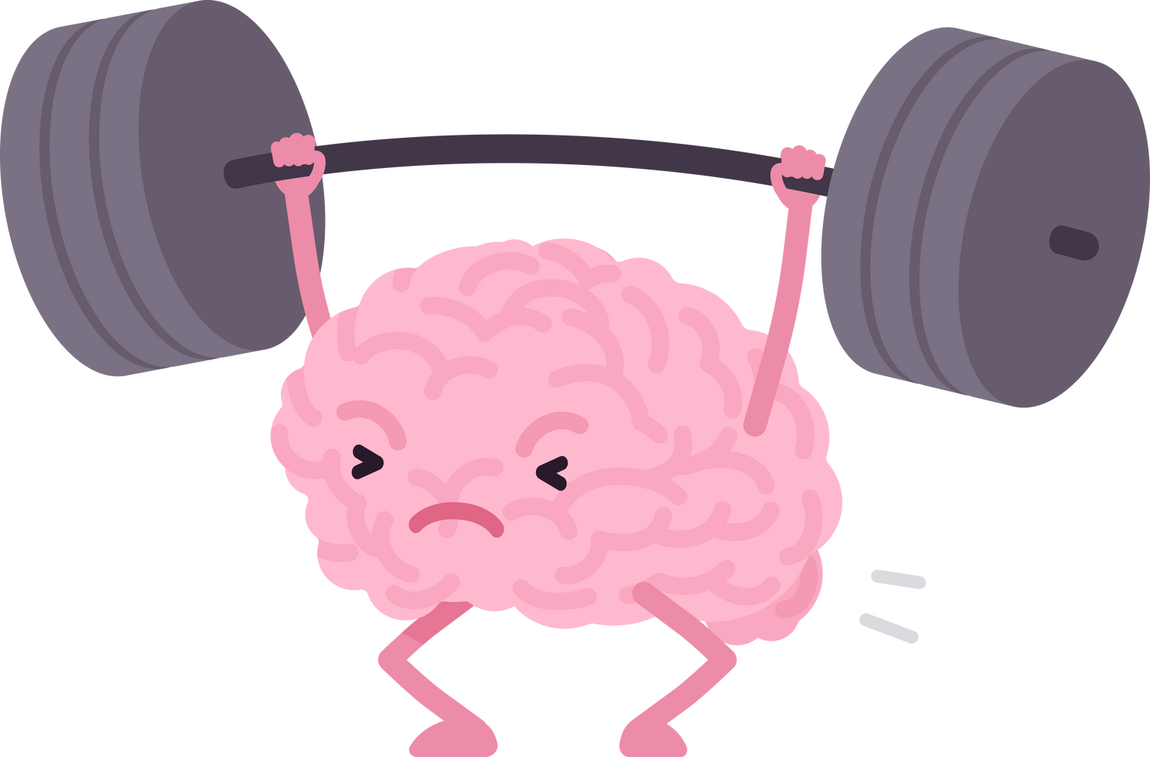
Team Members :
Samer Wael
Farouk Ashraf
Ahmed Sameh
Mohammed Wisam
Menna Ahmed
Abdelrahman Fawzy

Slide 3



INTRODUCTION
This project develops a deep learning model trained on MRI images to classify brain scans as either healthy or tumorous. The model aims to aid in early diagnosis by accurately detecting tumors in new MRI images.

Slide 4

WEEK 1:
collect MRI image from “Kaggle”
Data preprocessing
resize
data
Normalize data
Split the data
into training and
testing sets

Slide 5
WEEK 2:
Exploratory Data Analysis (EDA):
All The Data = 3251
Tumor Data = 1654

Slide 6
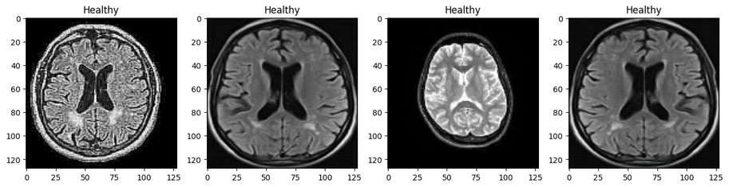
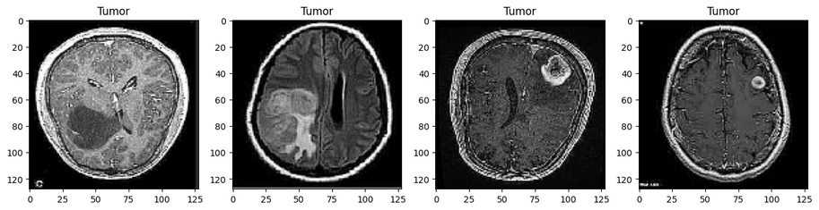
WEEK 2:
Exploratory Data Analysis (EDA):

Slide 7
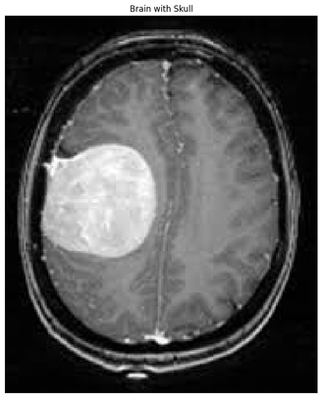
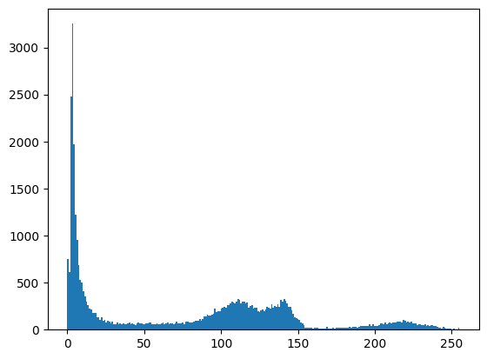
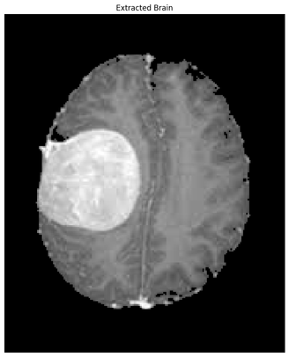
WEEK 2:
Skull Stripping

Slide 8
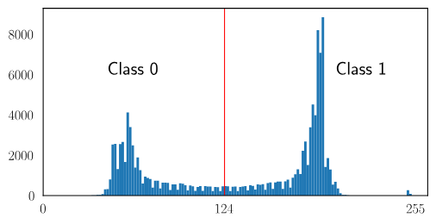
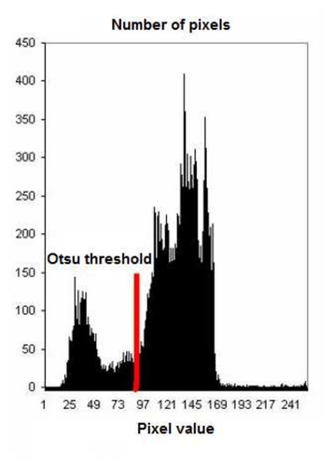
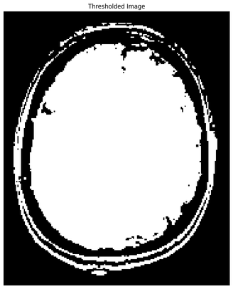
WEEK 2:
Skull Stripping

Slide 9
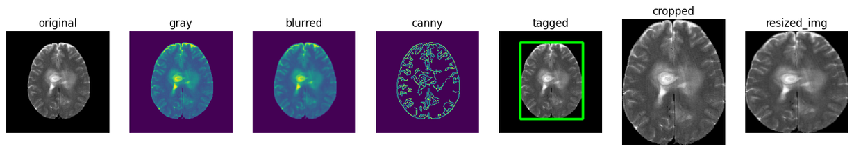


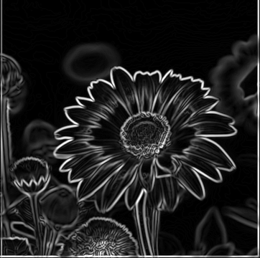
WEEK 2:
preprocessing
gray
Blur
Grad

Slide 10
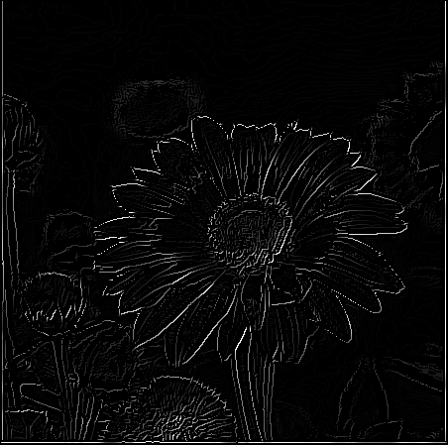
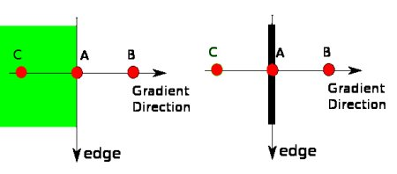
WEEK 2:
preprocessing
non-max
suppression

Slide 11

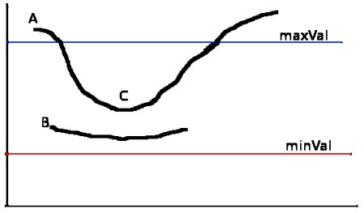
WEEK 2:
preprocessing
Double thresholding

Slide 12
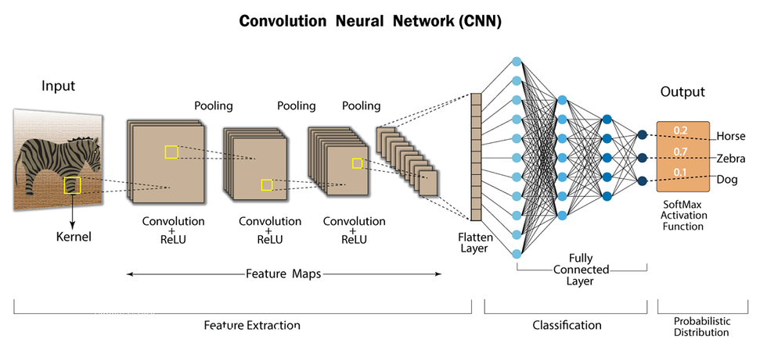


WEEK 3:
Why CNN ?
Building The CNN Model:

Slide 13
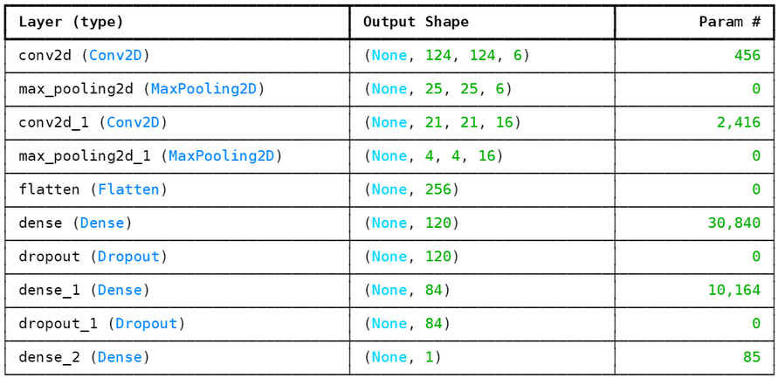
WEEK 3:
Building The CNN Model:
How the Param are calculated?
(kernel_height * kernel_width * input_channels + 1) * number_of_filters

Slide 14
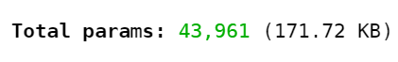
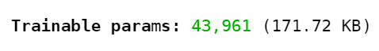
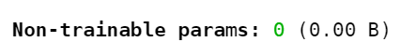
WEEK 3:
Building The CNN Model:

Slide 15
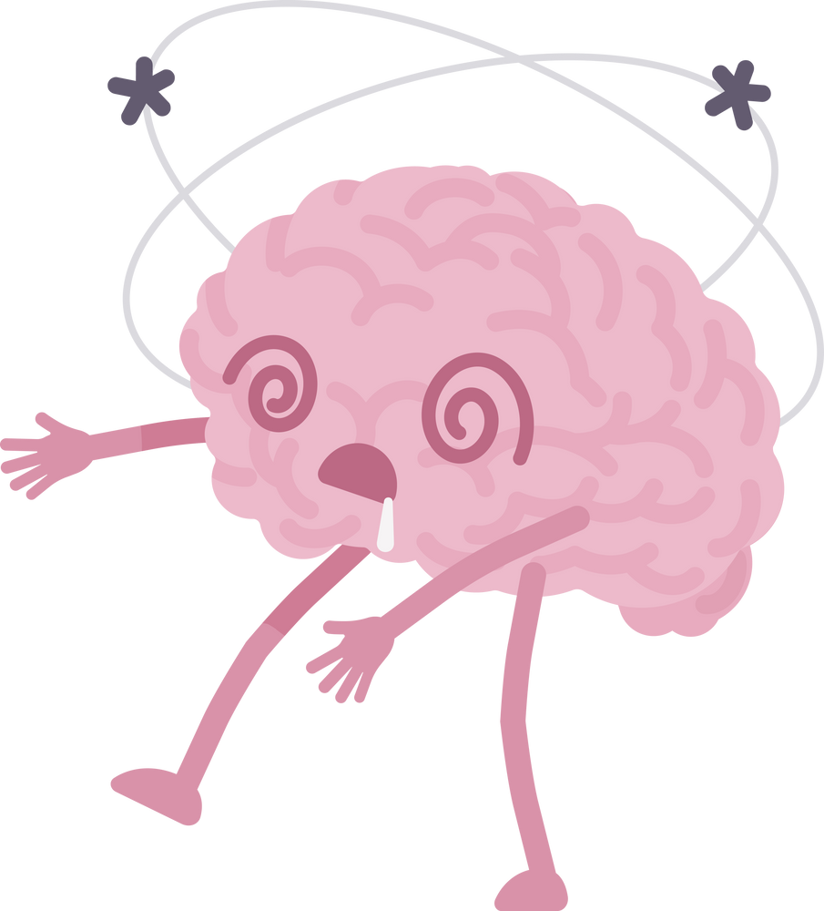

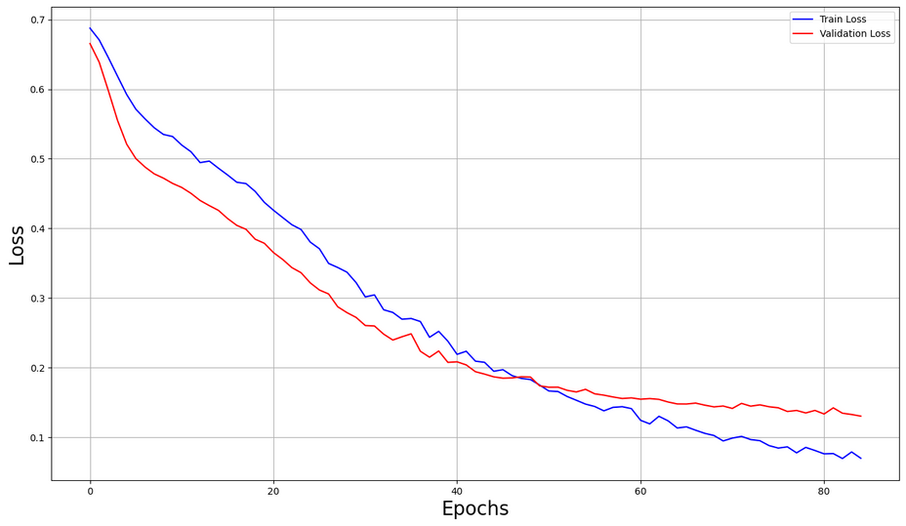
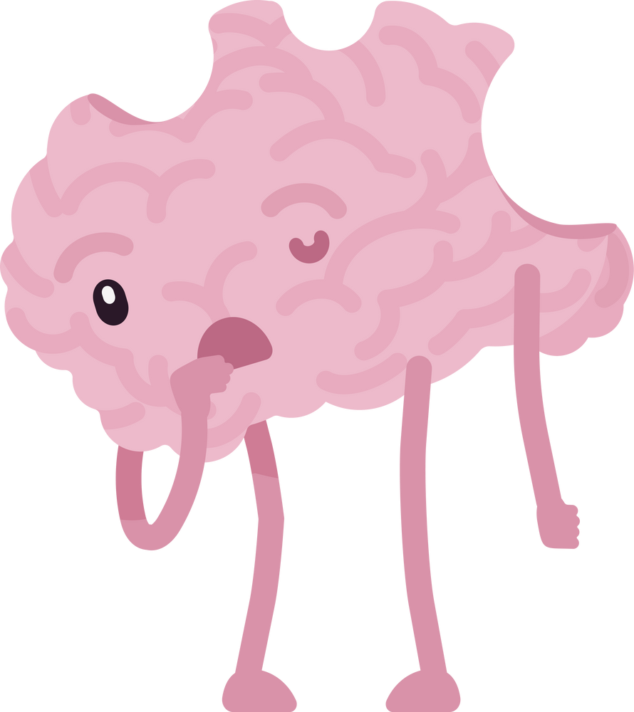

WEEK 3:
The Loss Journey Plot

Slide 16

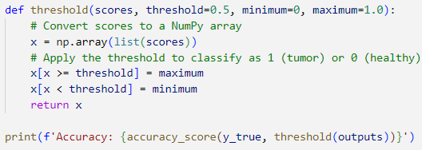

THRESHOLDING AND ACCURACY CALCULATION

Slide 17
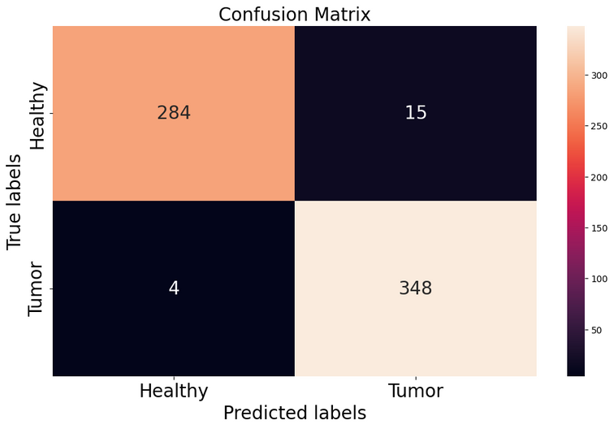
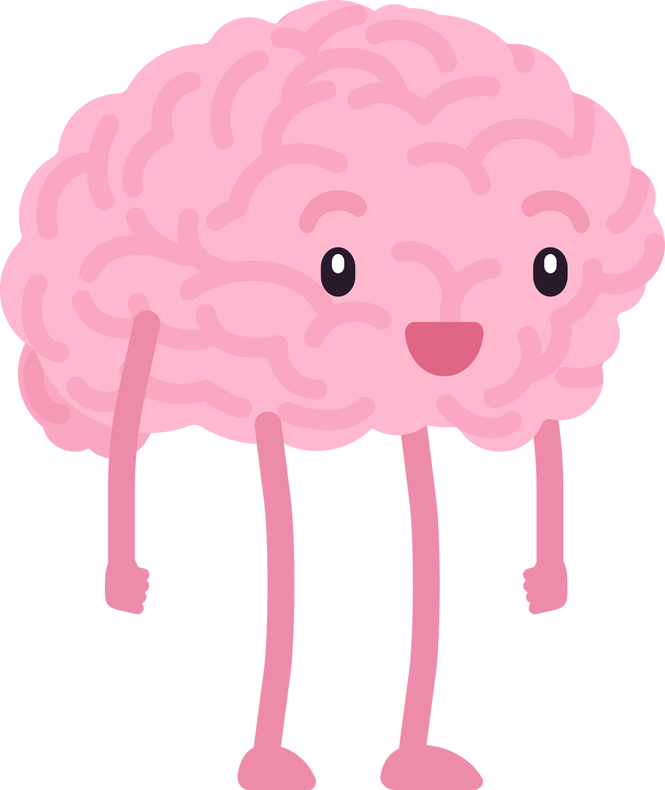
CONFUSION MATRIX PLOT

Slide 18
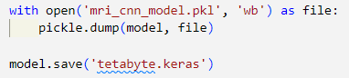
WEEK 3:
Saving The CNN Model:

Slide 19

WEEK 4:
Model Deployment

Slide 20
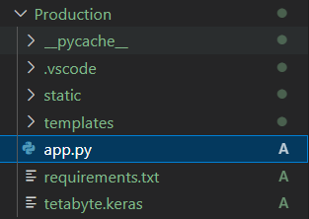
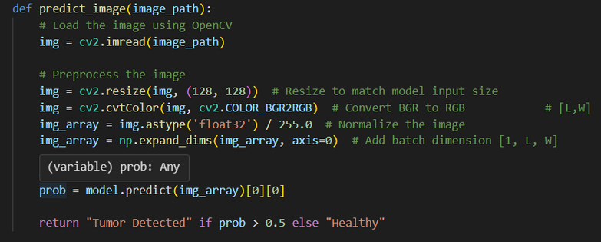
FLASK AND MODEL PREPRATION

Slide 21
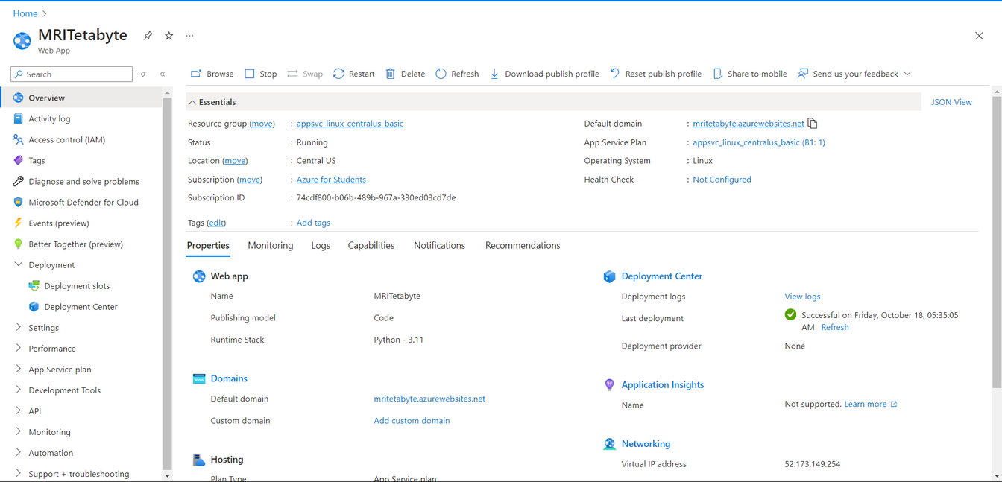
AZURE MODEL DEPLOYMENT

Slide 22

MODEL DEPLOYMENT
FINAL PRODUCT

Slide 23
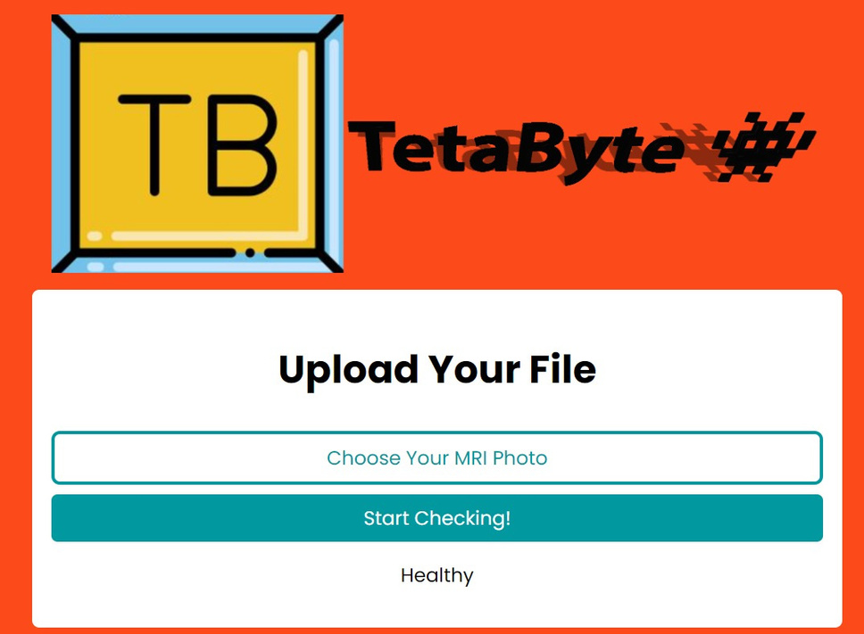
MODEL DEPLOYMENT FINAL PRODUCT

Slide 24
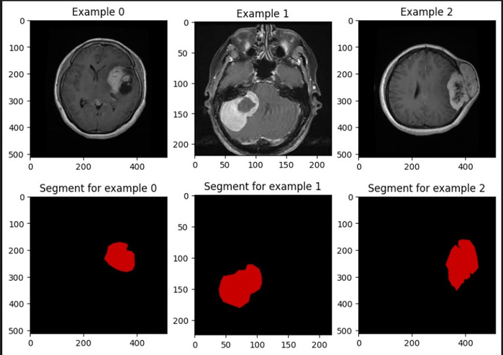
FUTURE PLANS:
Find the average tumor volume
Finding common tumor locations

Slide 25
THANK YOU
I hope you can get useful knowledge from this presentation. Good luck !

